Slide 1
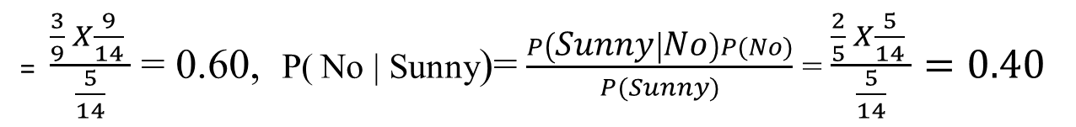
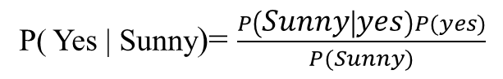
Weather
No
Yes
Weather | No | Yes | Row Total
Sunny | 2 | 3 | 5 | P(sunny)= 5/14
Overcast | 0 | 4 | 4 | P(overcast)=4/14
Rainy | 3 | 2 | 5 | P(Rainy)= 5/14
Column Total | 5 | 9 | 14
 | P(no)=5/14 | P(yes)=9/14
Step4: Apply Probabilities from frequency table to Bayes Theorem
P( Yes | Sunny) > P( No | Sunny) . Hence, The Player will play the game.

Slide 2
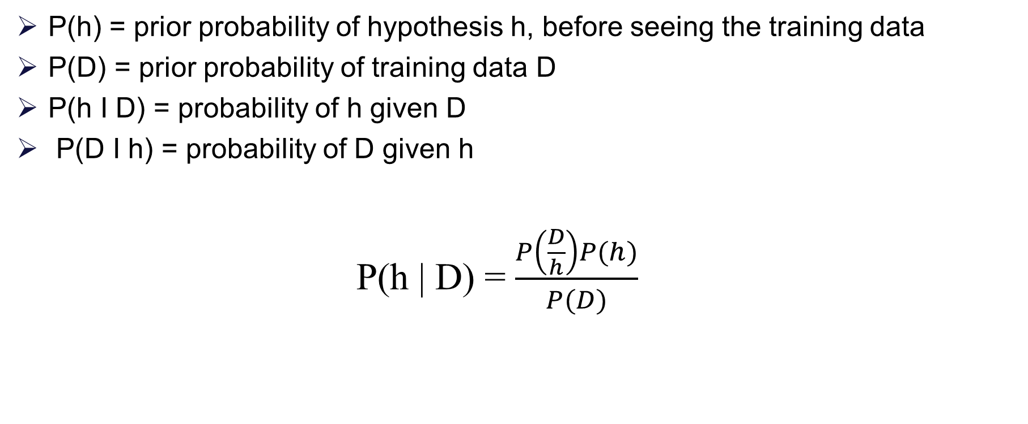
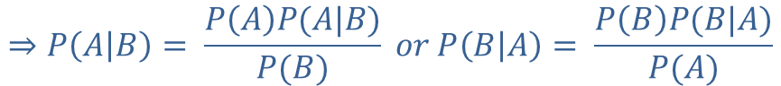
$$∵P\left(B\right)P\left(B | A\right)=P\left(A\right)P\left(B | A\right)=P\left(A∩B\right)$$
Baye’s Theorem
$$⇒P\left(A | B\right)= \frac{P\left(A\right)P(A|B)}{P(B)} or P\left(B | A\right)= \frac{P\left(B\right)P(B|A)}{P(A)}$$

Slide 3
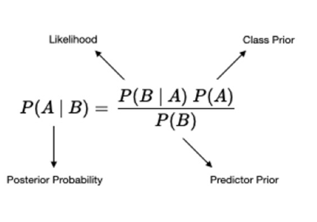
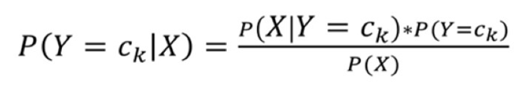
Generative Model
Build model to estimate the posterior probability P(Y | X) by estimating
likelihood of data given target (hypothesis) P(X | Y)
Prior probabilities over target P(Y)
In general, for a specific class Y=c_{k},

Slide 4
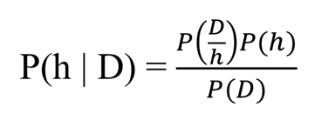
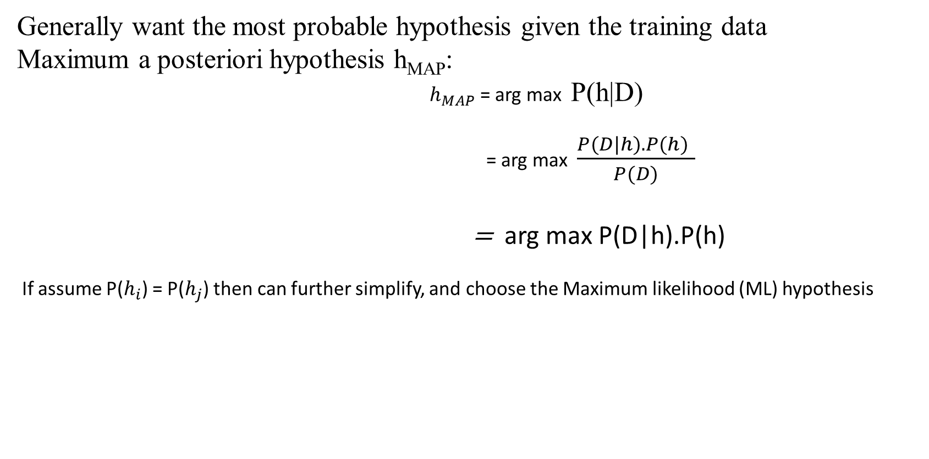
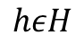
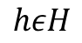
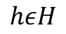
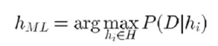
Choosing hypothesis
Arg max, or argmax, is a mathematical term that refers to the input points at which a function's output value is maximized. It's used to find the largest possible values given constraints, and is often used in machine learning to find the class with the largest predicted probability.

Slide 5
Bayesian Learning
Naive Bayes is a set of simple and efficient machine learning algorithms for solving a variety of classification and regression problems.
Naive Bayes assumes conditional independence where Bayes theorem does not. This means the relationship between all input features are independent.
Bayesian learning algorithms that calculate explicit probabilities for hypotheses, such as the Naive Bayes classifier, are among the most practical approaches to certain types of learning problems.
Example: Problem of learning to classify text documents such as electronic news articles.
For such learning tasks, the Naive Bayes classifier is among the most effective known algorithms.

Slide 6
Features of Bayesian learning
Prior knowledge can be combined with observed data to determine the final probability of a hypothesis.
Prior knowledge is provided by asserting
prior probability for each candidate hypothesis, and
probability distribution over observed data for each possible hypothesis.
New instances can be classified by combining the predictions of multiple hypothesis, weighted by their probabilities.

Slide 7
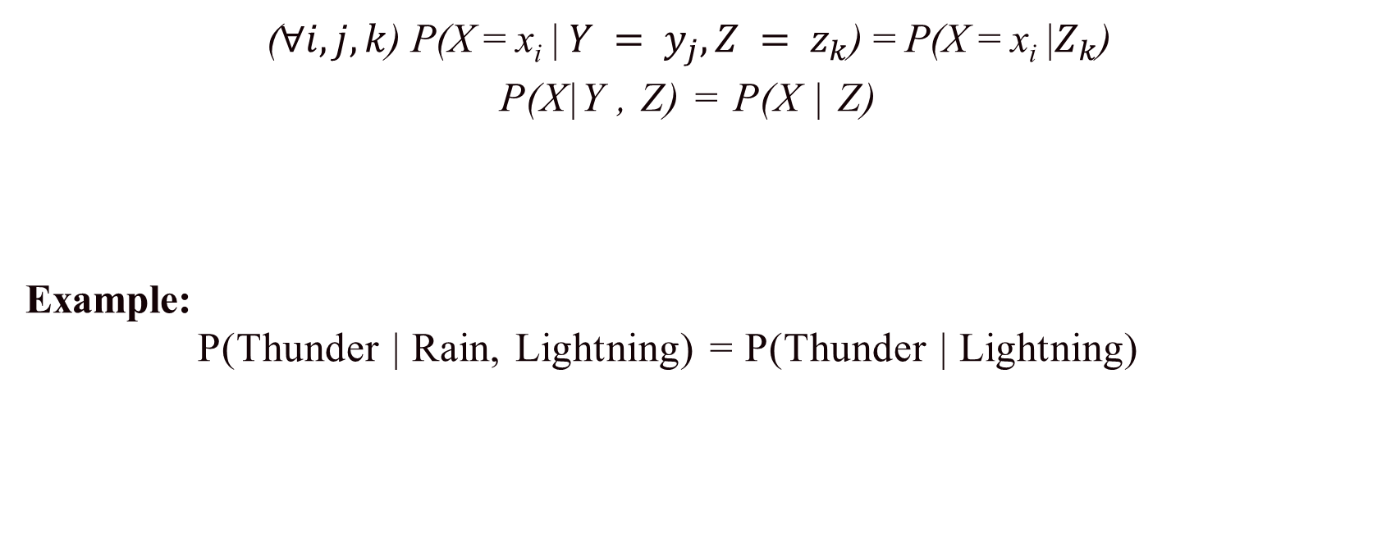
Conditional Independence
Definition: X is conditionally independent of Y given Z, if the probability distribution governing X is independent of the value of Y, given the value of Z

Slide 8
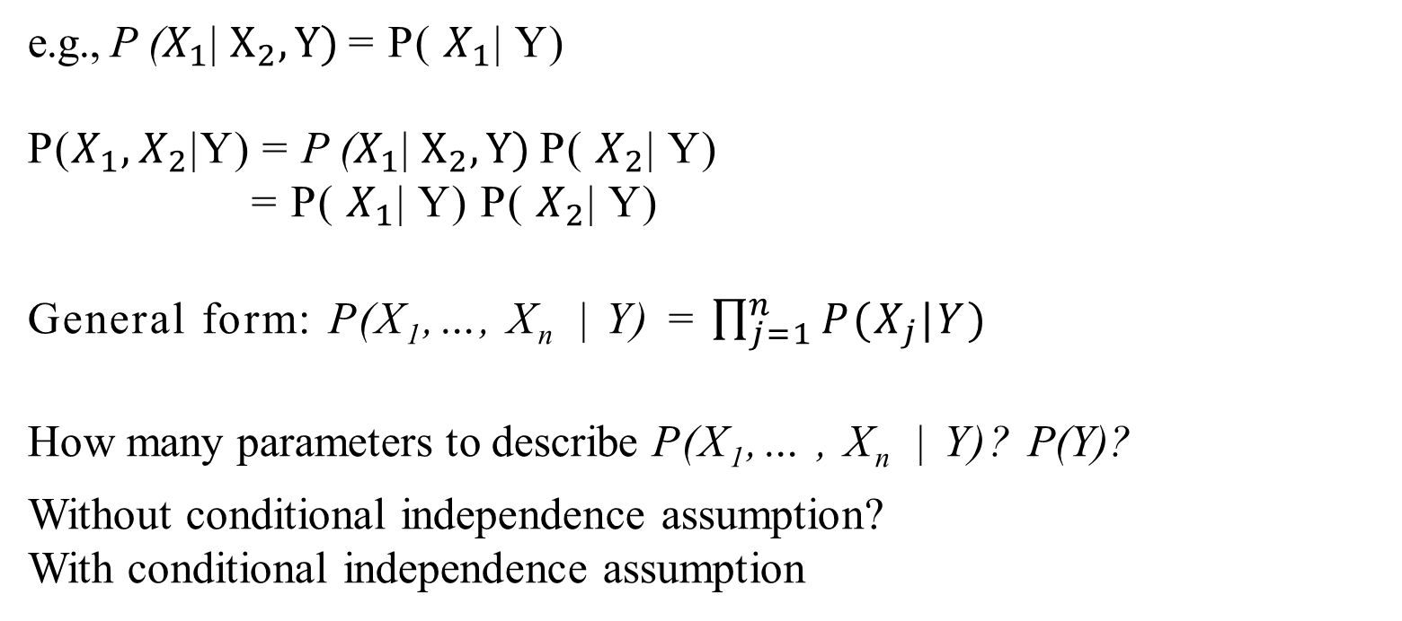
Applying Conditional Independence
Naive Bayes assumes X_{i} are conditionally independent given Y.

Slide 9
Example :
S. No | Outlook | Temp | Humidity | Windy | Play Tennis
1 | Rainy | Hot | High | False | No
2 | Rainy | Hot | High | True | No
3 | Overcast | Hot | High | False | Yes
4 | Sunny | Mild | High | False | Yes
5 | Sunny | Cool | Normal | False | Yes
6 | Sunny | Cool | Normal | True | No
7 | Overcast | Cool | Normal | True | Yes
8 | Rainy | Mild | High | False | No
9 | Rainy | Cool | Normal | False | Yes
10 | Sunny | Mild | Normal | False | Yes
11 | Rainy | Mild | Normal | True | Yes
12 | Overcast | Mild | High | True | Yes
13 | Overcast | Hot | Normal | False | Yes
14 | Sunny | Mild | High | True | No
If the feature of
Today = (Outlook is Sunny ,
Temp is Hot,
Humidity is Normal,
Windy is False),
then the player will
play or not?

Slide 10
Solution:
Outlook | Yes | No
Rainy | 2/9 | 3/5 | 5/14
Overcast | 4/9 | 0/5 | 4/14
Sunny | 3/9 | 2/5 | 5/14
Temp | Yes | No
Hot | 2/9 | 2/5 | 4/14
Mild | 4/9 | 2/5 | 6/14
Cool | 3/9 | 1/5 | 4/14
Humidity | Yes | No
High | 3/9 | 4/5 | 7/14
Normal | 6/9 | 1/5 | 7/14
Windy | Yes | No
True | 3/9 | 3/5 | 6/14
False | 6/9 | 2/5 | 8/14

Slide 11
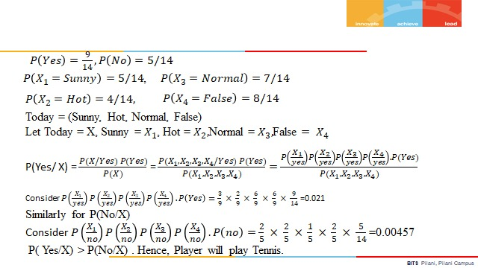
Outlook | Yes | No
Rainy | 2/9 | 3/5 | 5/14
Overcast | 4/9 | 0/5 | 4/14
Sunny | 3/9 | 2/5 | 5/14
Temp | Yes | No
Hot | 2/9 | 2/5 | 4/14
Mild | 4/9 | 2/5 | 6/14
Cool | 3/9 | 1/5 | 4/14
Solution:
Humidity | Yes | No
High | 3/9 | 4/5 | 7/14
Normal | 6/9 | 1/5 | 7/14
Windy | Yes | No
True | 3/9 | 3/5 | 6/14
False | 6/9 | 2/5 | 8/14

Slide 12
Example:
(a) Estimate Conditional Probability of each attributes {colour, legs, height, smelly} for the species classes: { S1, S2 } using the data given in the table.
(b) Using these probabilities in the table estimate the probabilities values for the
new instance – { Colour =Green , Legs = 2, Height = Tall and Smelly= No}

Slide 13
No | Colour | Legs | Height | Smelly | Species
1 | White | 3 | Short | Yes | S1
2 | Green | 2 | Tall | No | S1
3 | Green | 3 | Short | Yes | S1
4 | White | 3 | Short | Yes | S1
5 | Green | 2 | Short | No | S2
6 | White | 2 | Tall | No | S2
7 | White | 2 | Tall | No | S2
8 | White | 2 | Short | Yes | S2

Slide 14
Solution:
P(S1)= , P(S2)= ,
Colour | S1 | S2
White | 2/4 | 3/4
Green | 2/4 | 1/4
Legs | S1 | S2
2 | ¼ | 4/4
3 | ¾ | 0/4
Height | S1 | S2
Tall | ¾ | 2/4
Short | ¼ | 2/4
Smelly | S1 | S2
Yes | ¾ | ¼
No | ¼ | 3/4

Slide 15
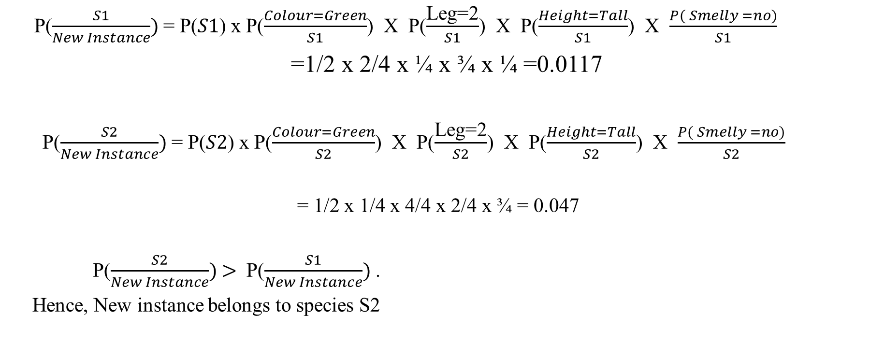
Colour | S1 | S2
White | 2/4 | 3/4
Green | 2/4 | 1/4
Legs | S1 | S2
2 | ¼ | 4/4
3 | ¾ | 0/4
Height | S1 | S2
Tall | ¾ | 2/4
Short | ¼ | 2/4
Smelly | S1 | S2
Yes | ¾ | ¼
No | ¼ | 3/4

Slide 16
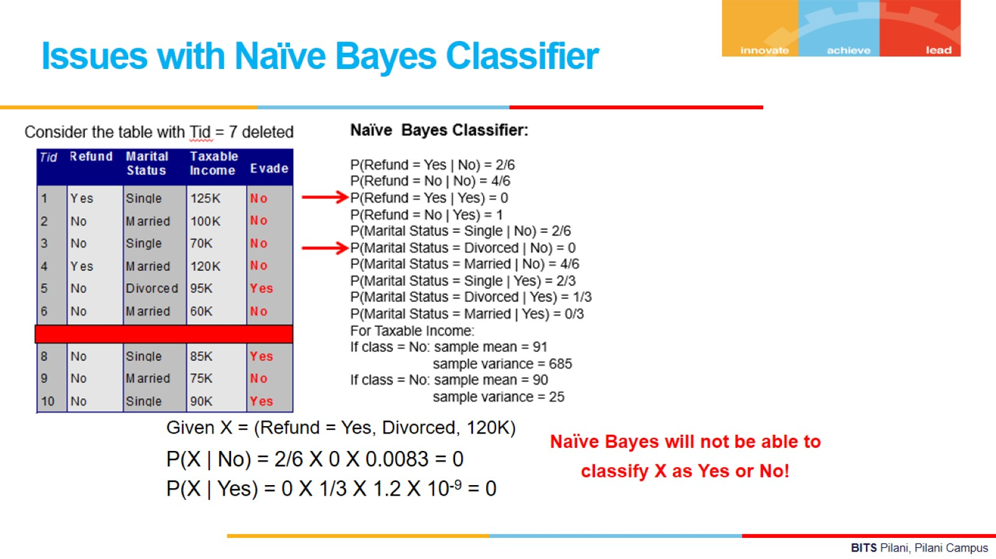

Slide 17
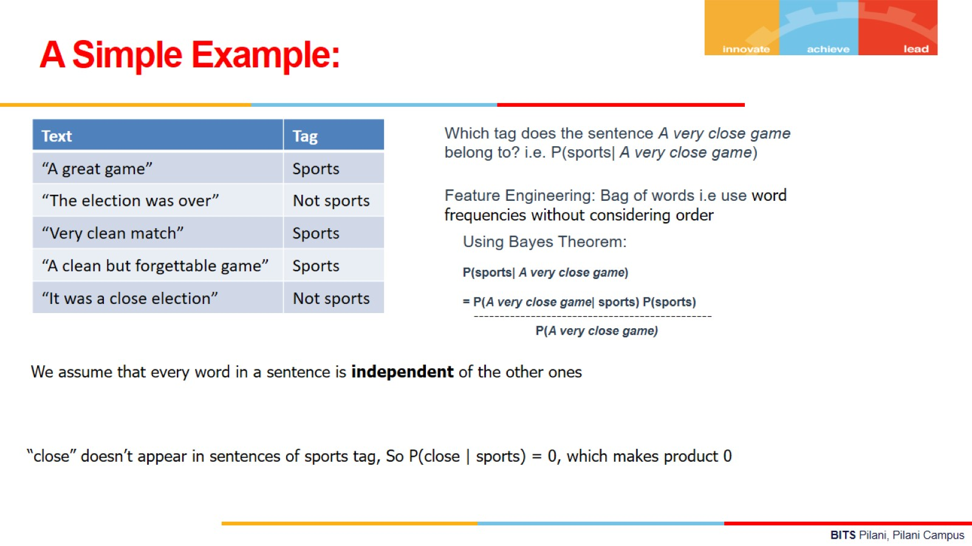

Slide 18
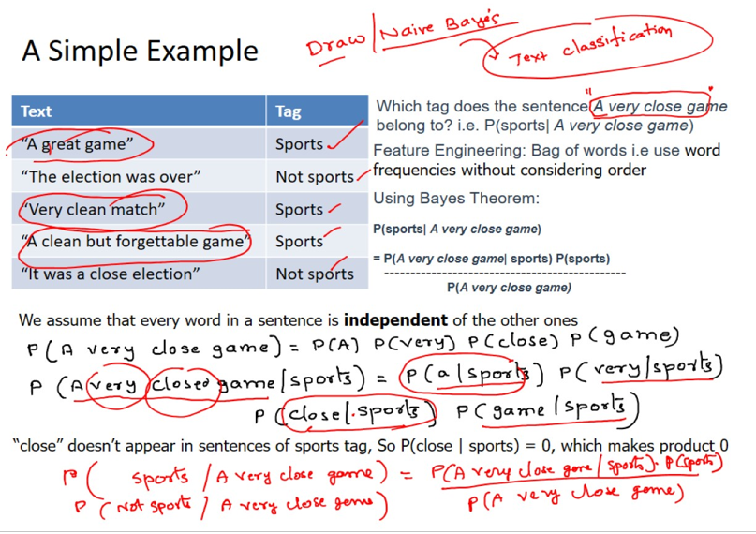

Slide 19
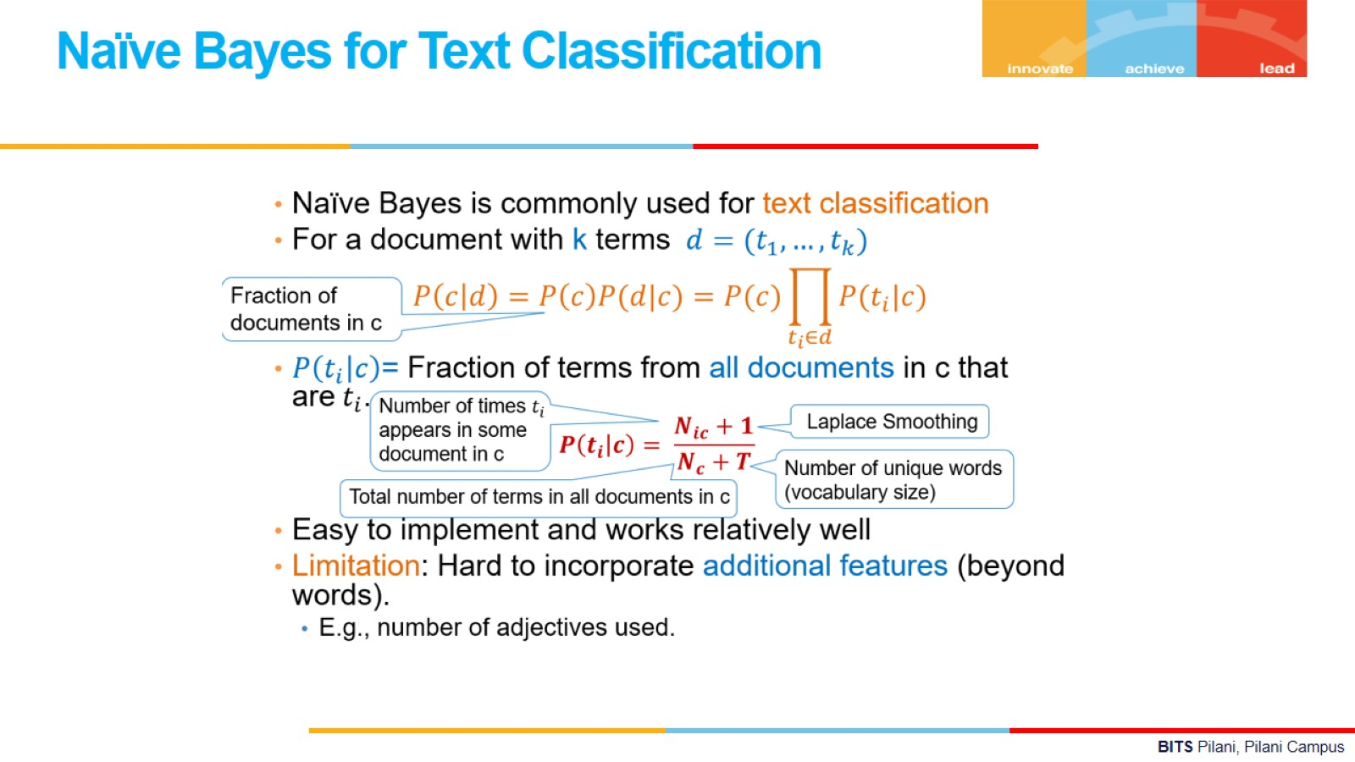

Slide 20
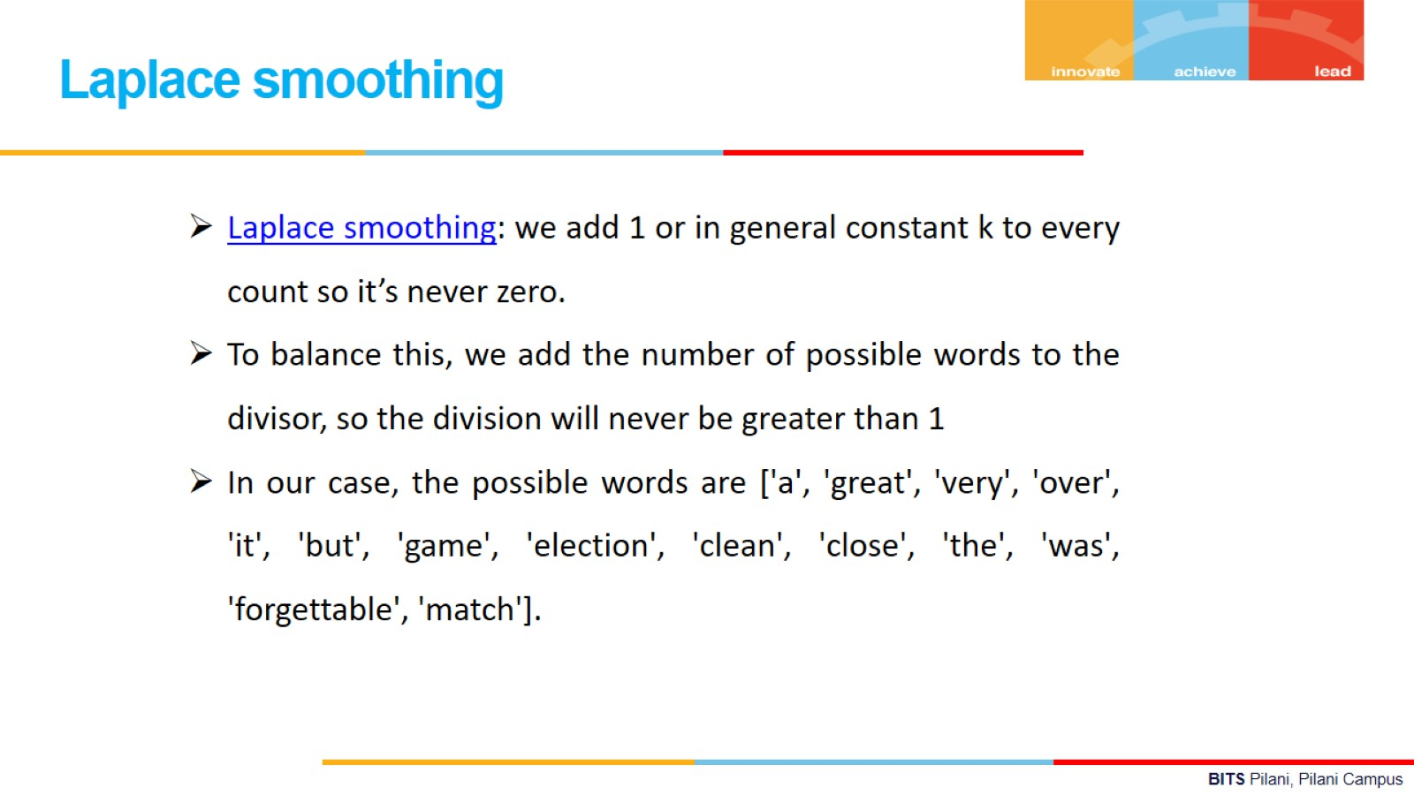
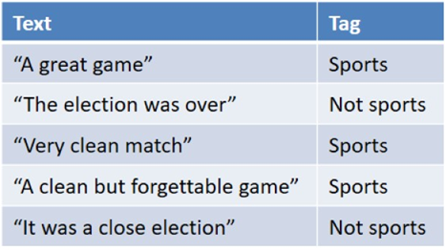

Slide 21
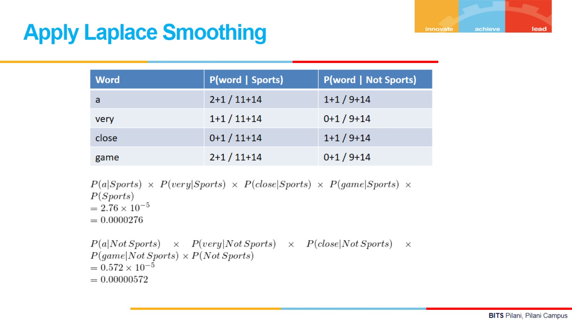

Slide 22
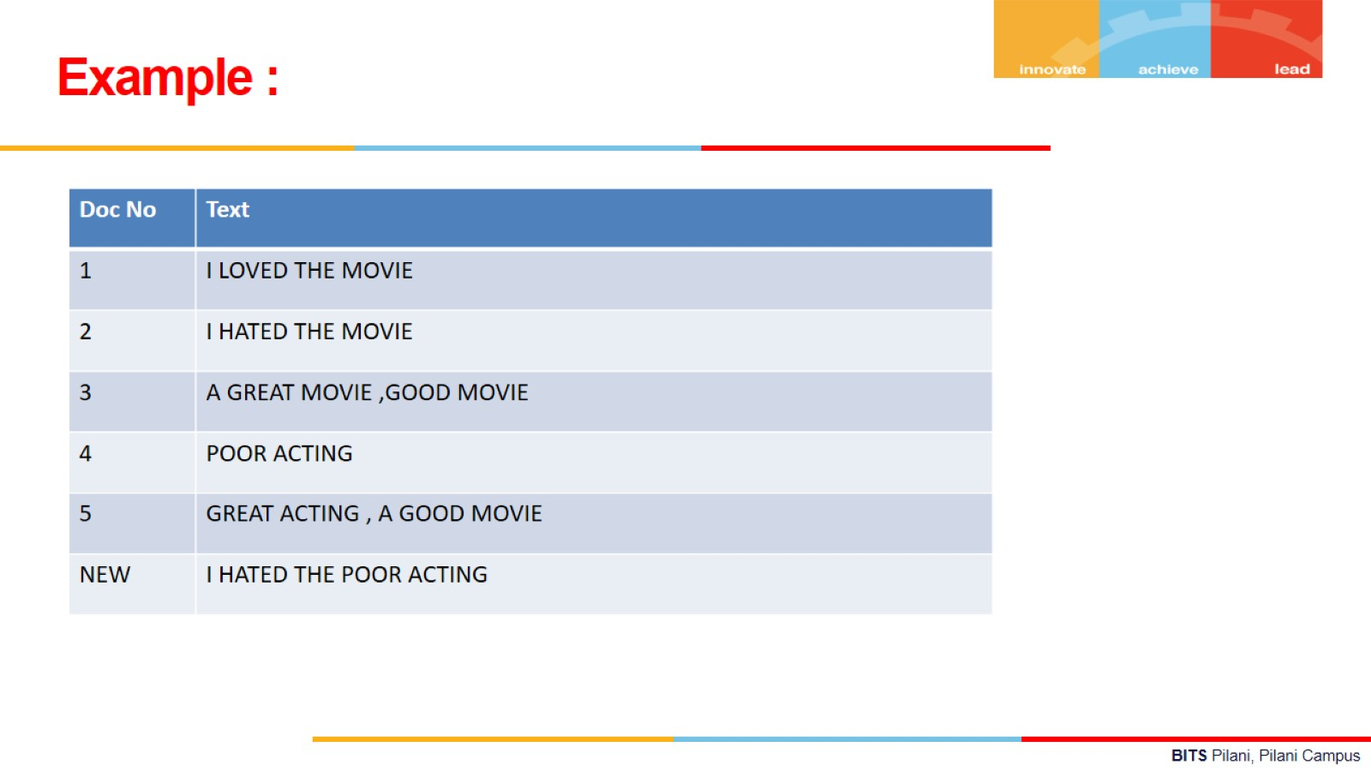

Slide 23
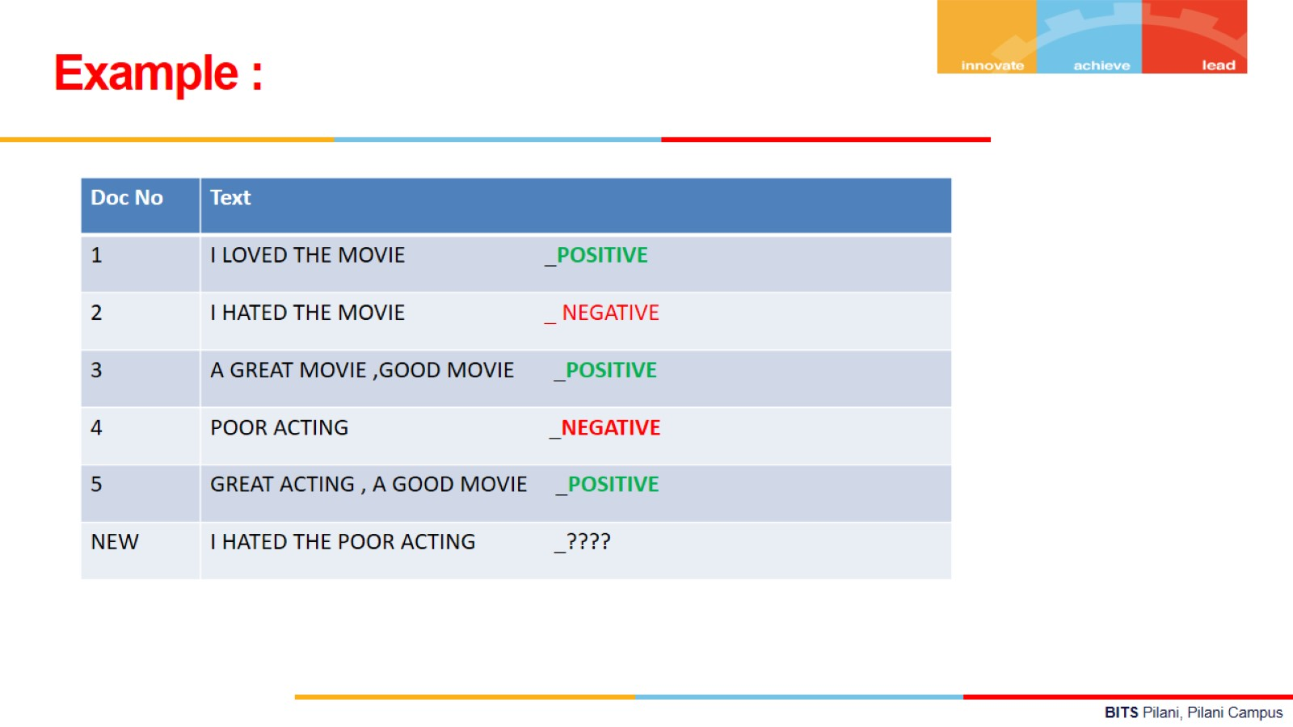

Solution:

Slide 24
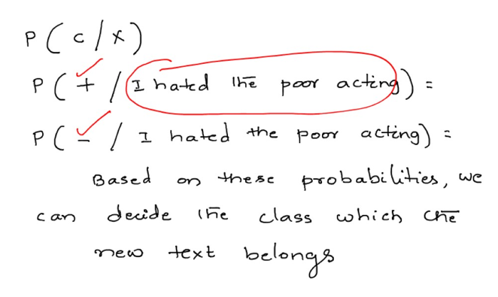
Contd..

Slide 25
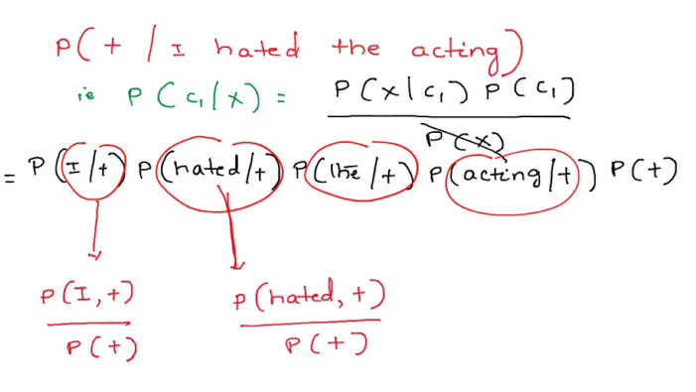
Contd..

Slide 26
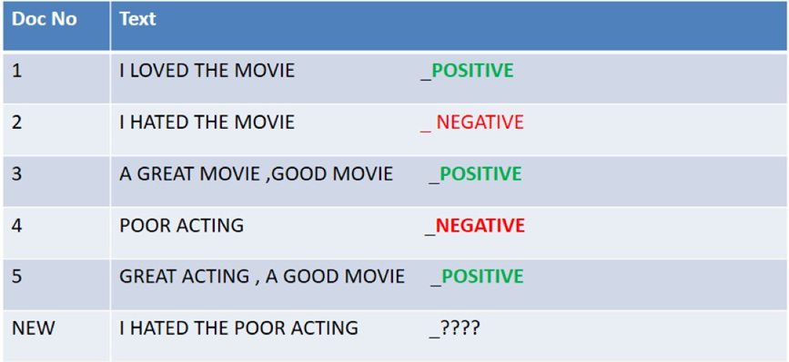
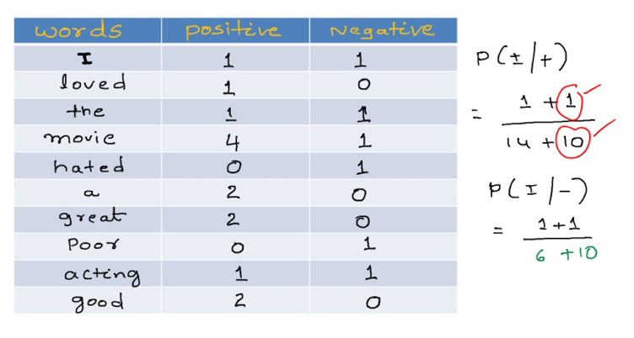
Contd..

Slide 27
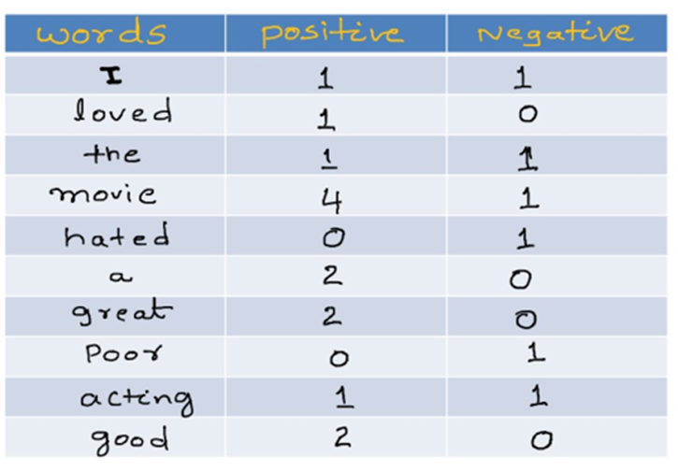
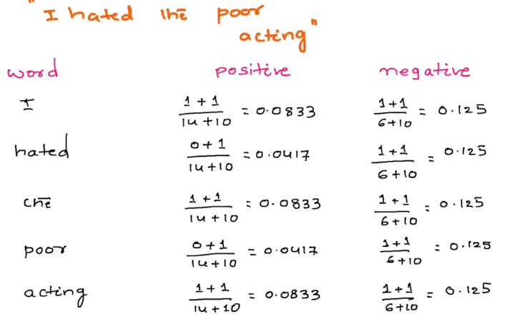
Contd..

Slide 28
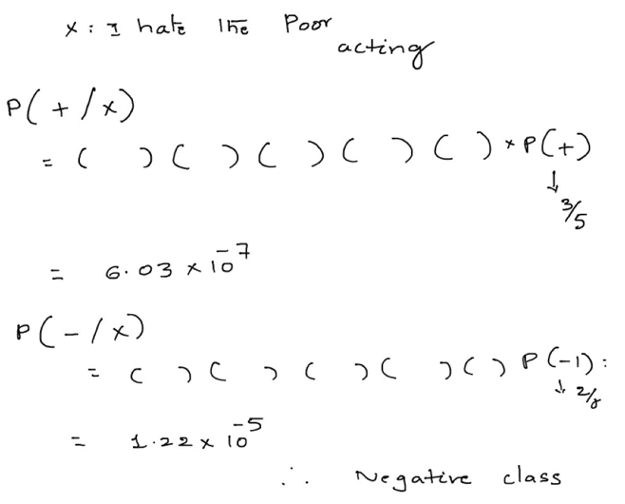
Contd..

Slide 29
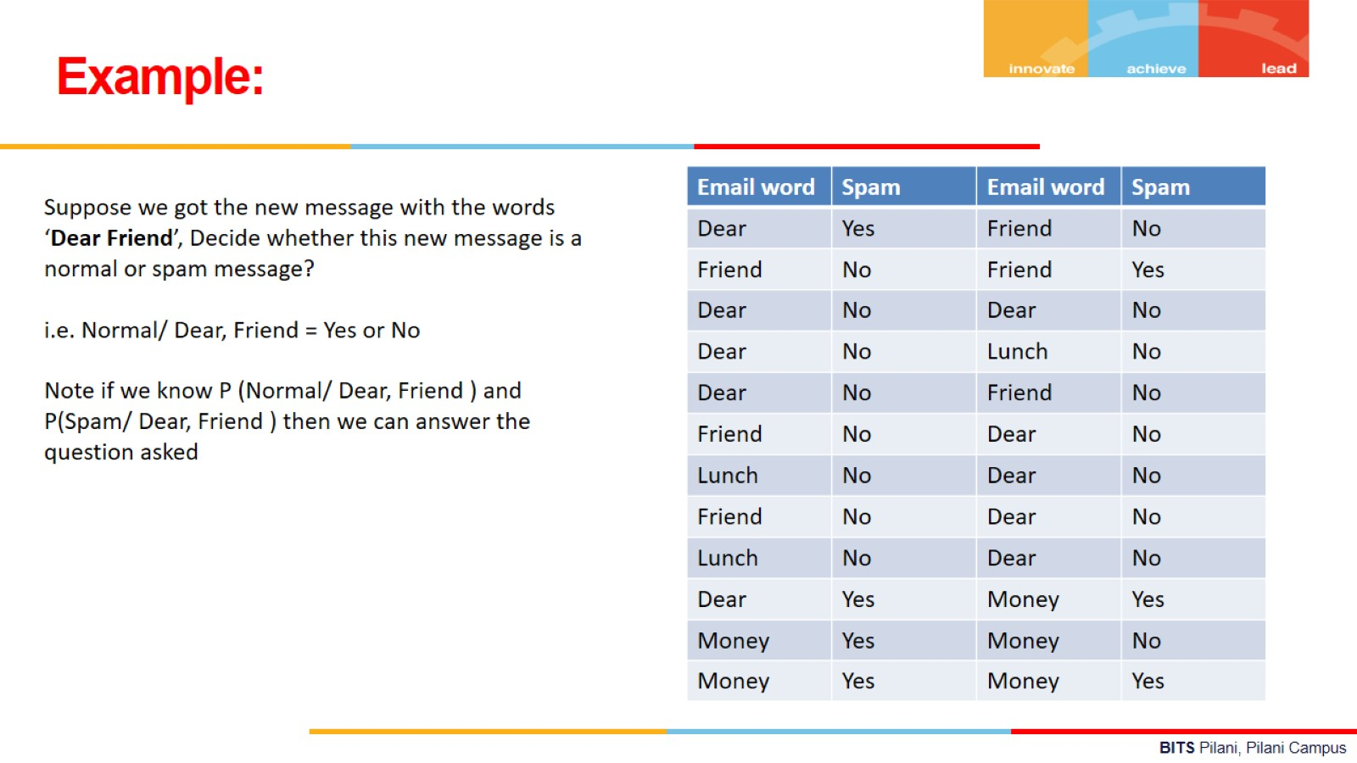

Slide 30
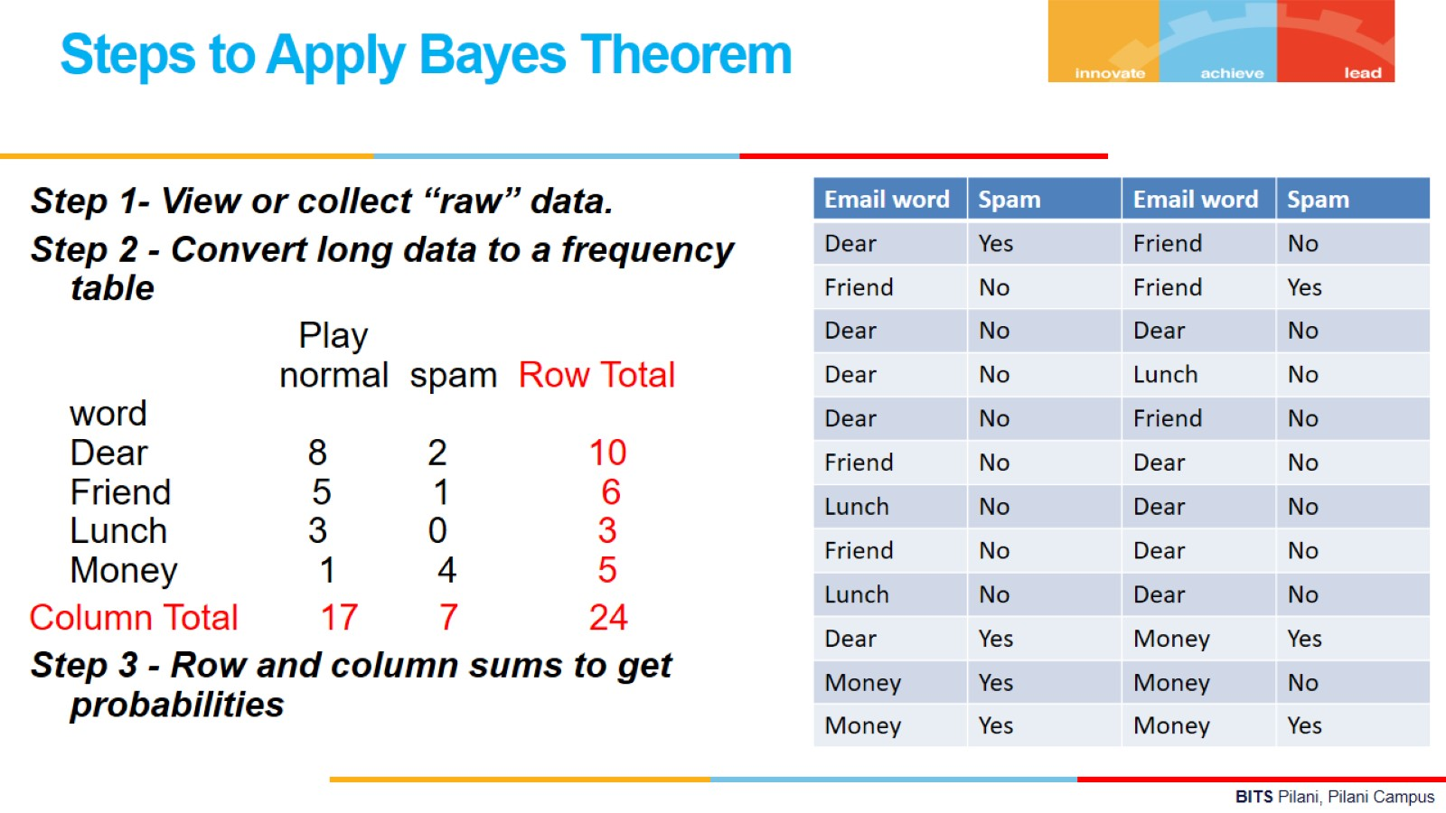

Slide 31
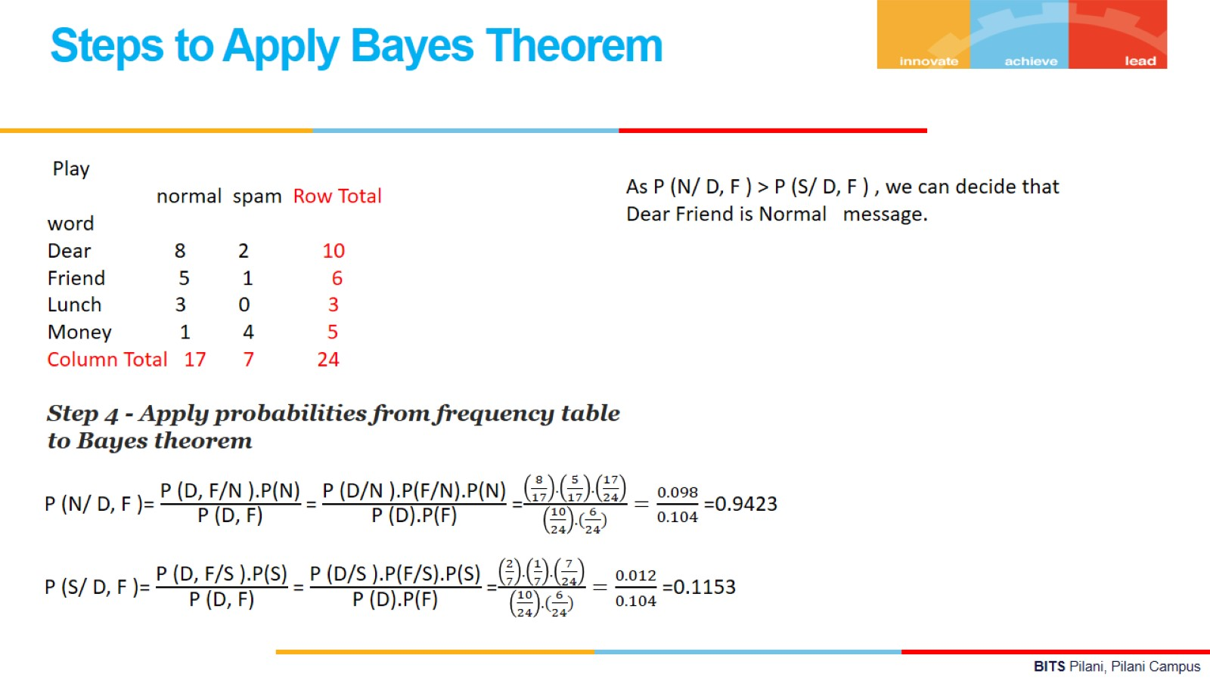

Slide 32
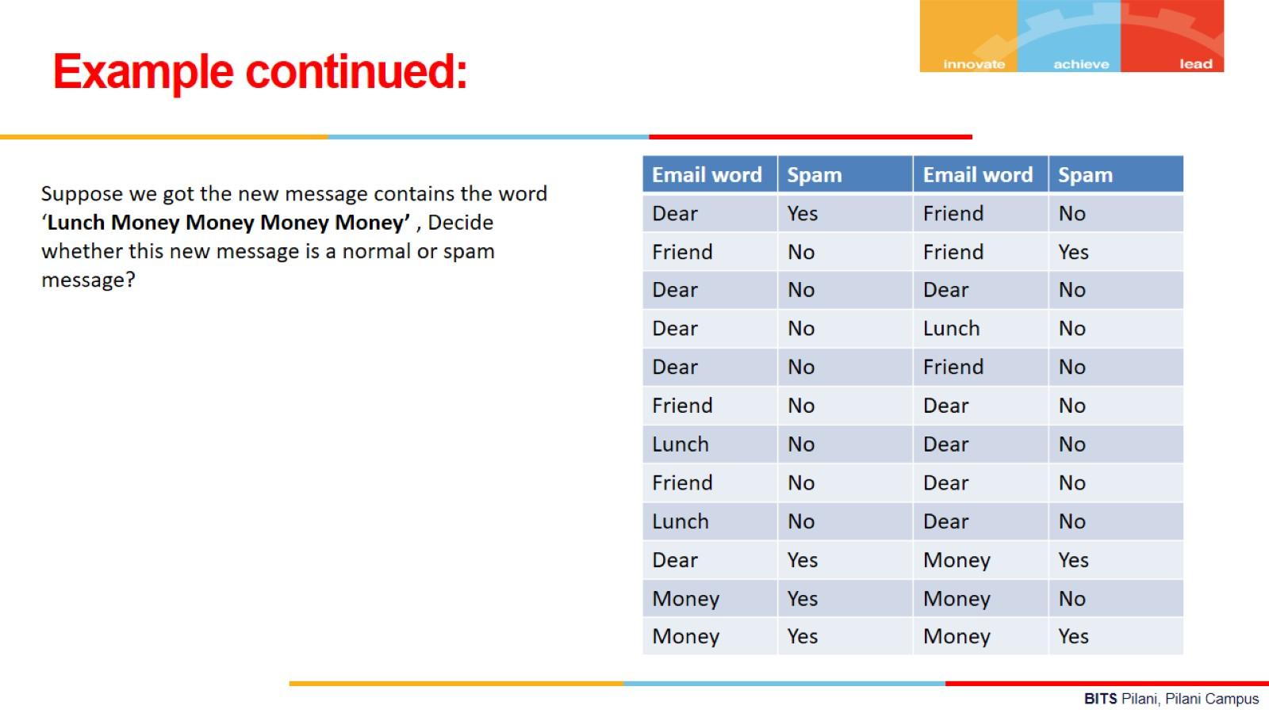

Slide 33
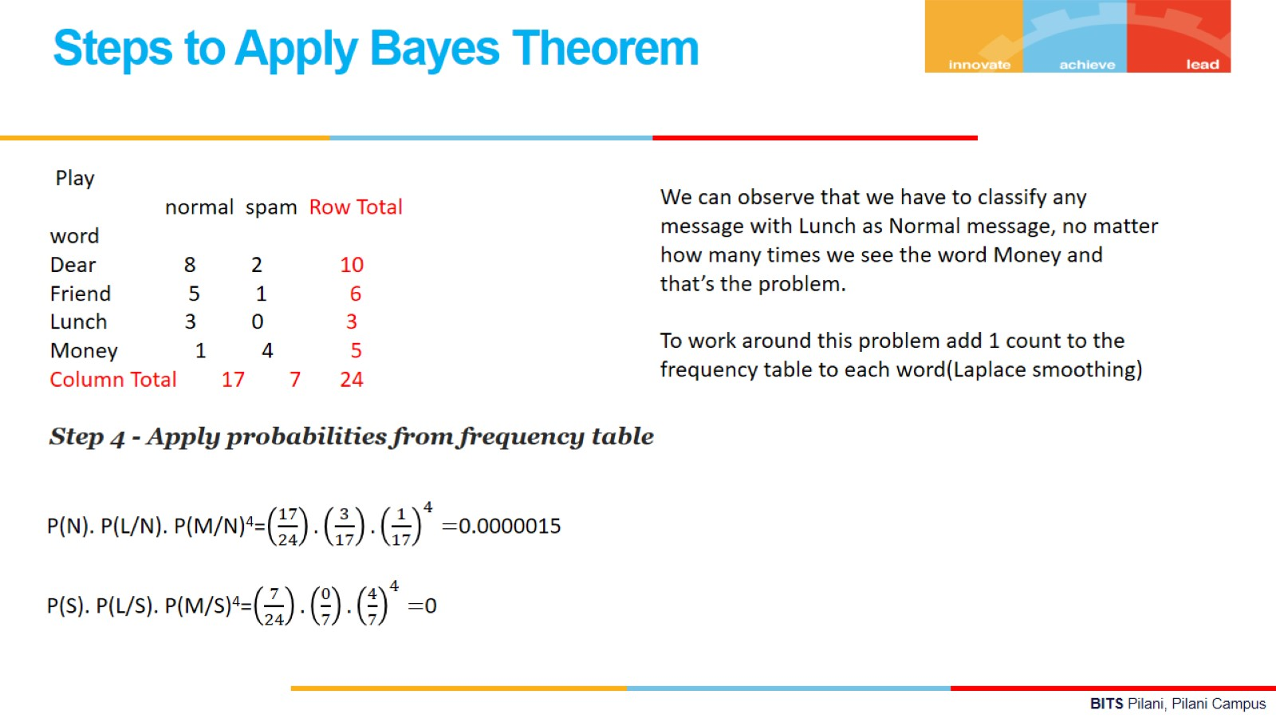

Slide 34
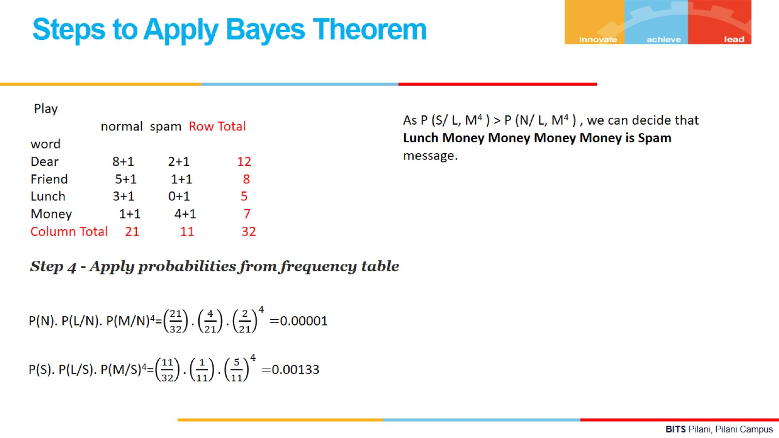

Slide 35
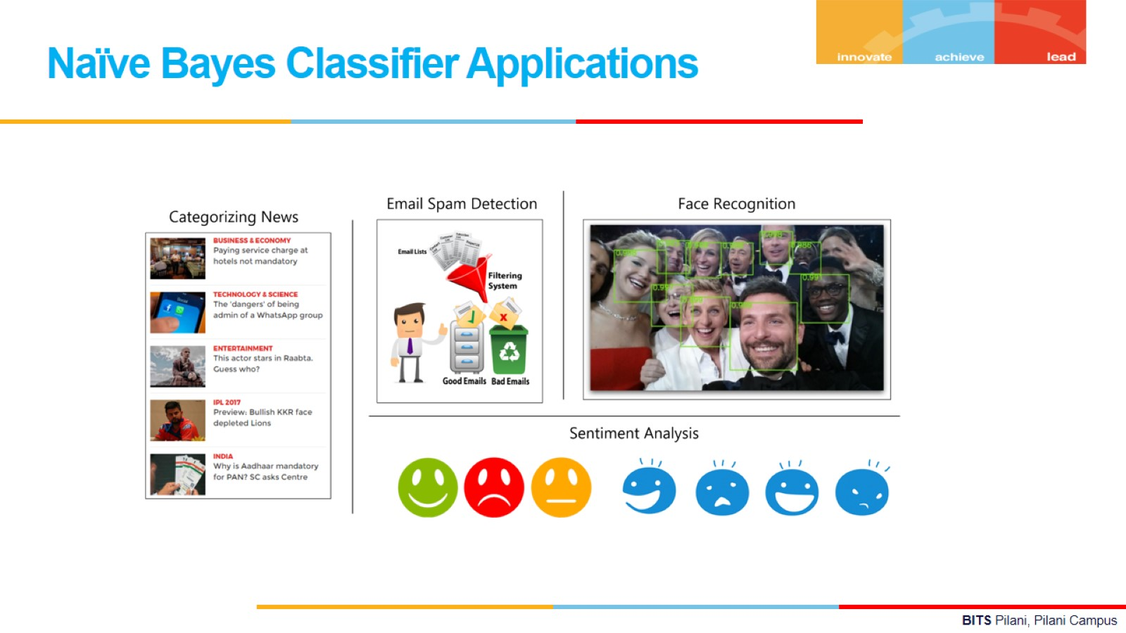

Slide 36
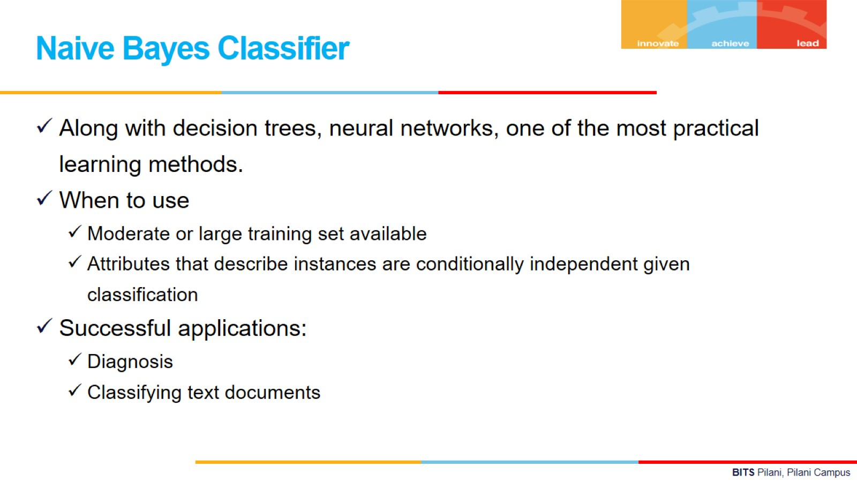

Slide 37
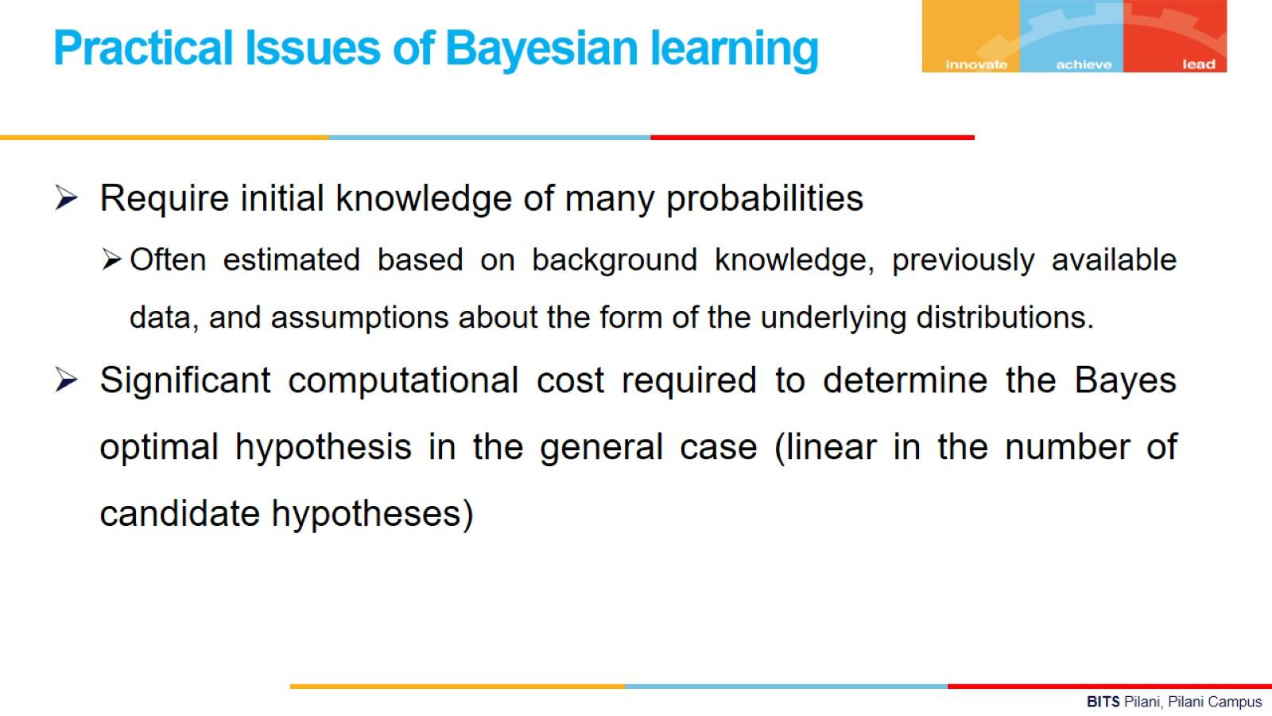

Slide 38
Practice problems
Problem 1
Two set of candidates are competing for the positions on the board of directors of a
company. The probabilities that the first and the second sets will win are 0.6 and 0.4
respectively. If the first set wins , the probability of introducing a new product is 0.8,
and the corresponding probability if the second set wins is 0.3. What is the probability
that the product will be introduced?

Slide 39
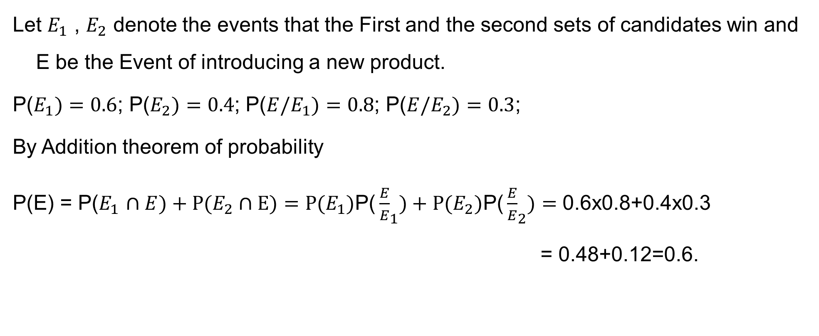
Problem 1
Solution:

Slide 40
Problem 2
In a bolt factory, Machines A, B, C manufacture respectively 25%,35% and 40 % of the total. Of their output 5,4,2 percent are known to be defective bolts.
A bolt is drawn at random from the product and is found to be defective. What are the probabilities that it was manufactured by
(i) Machine A
(ii) Machine B or C

Slide 41
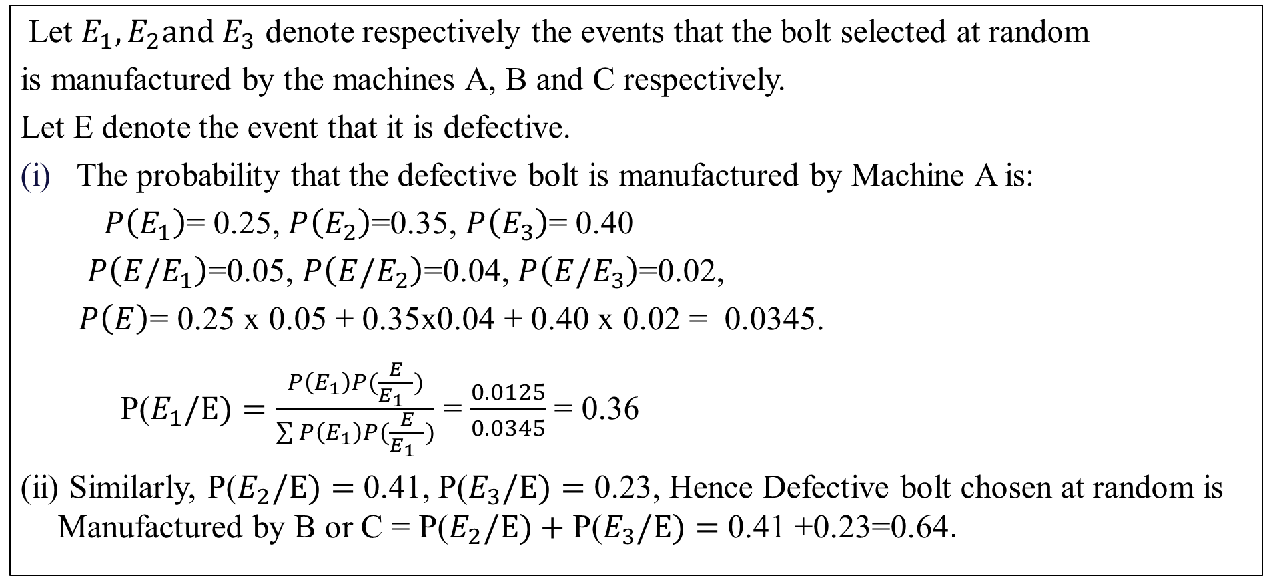
Problem 2
Solution:

Slide 42
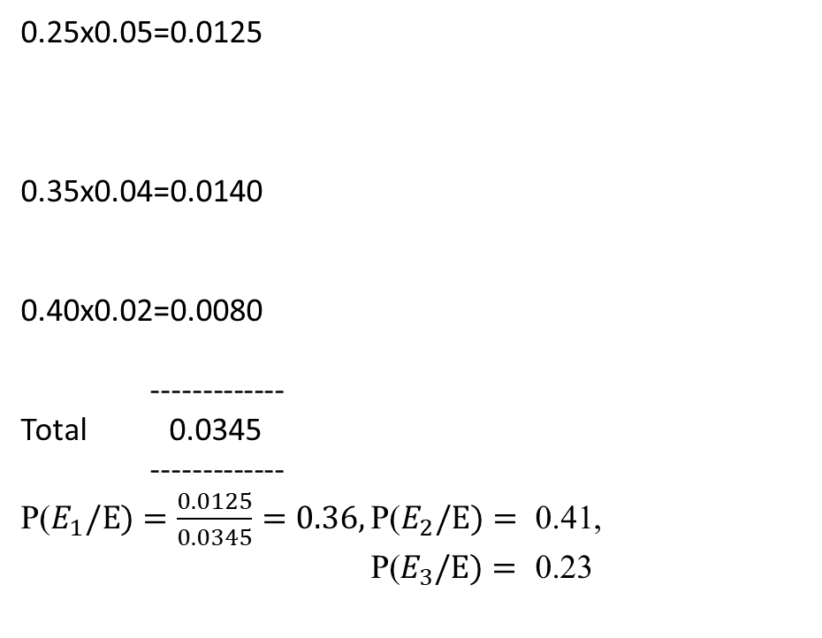
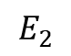
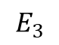
TREE DIAGRAM
0.05
E
E1
0.25
0.04
0.35
E
0.40
E
0.02
E

Slide 43
Problem 3
The results of an investigation by an expert on a fire accident in a skyscraper are summarized below:
P(There should have been short circuit)=0.8
P(LPG cylinder explosion)
Chance of fire accident is 30% given a short circuit and 95% given an LPG explosion.
Based on these, What do you think is the most probable causes of fire? Statistically justify your answer.

Slide 44
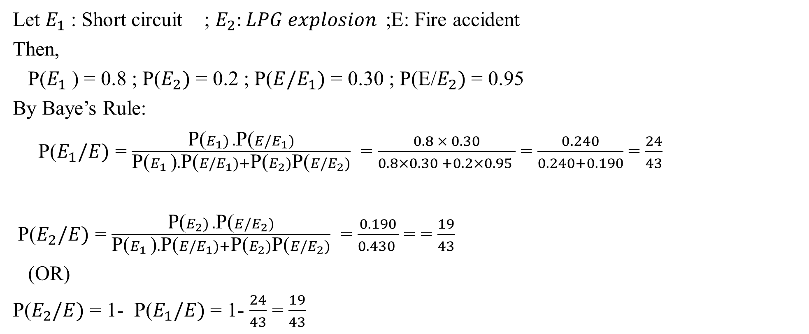
Solution:

Slide 45
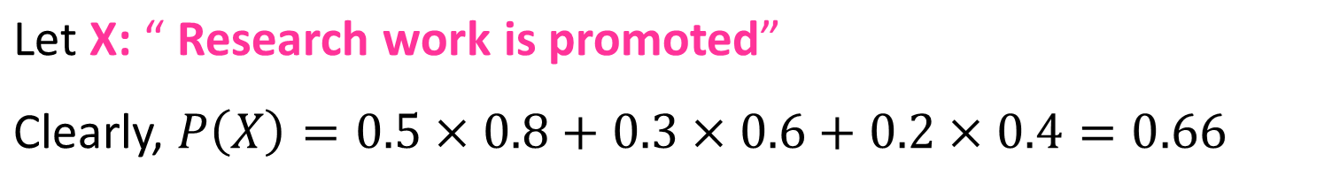

Problem 4
The chances that an academician, a business man and a politician becoming Vice Chancellor of an university are 0.5, 0.3 and 0.2 respectively. The probability that research work will be promoted in the university by these 3 gentlemen are respectively are 0.8, 0.6 and 0.4. It is found Research work has been promoted by the university. What is the chance that an academician has become the VC?
Solution:

Slide 46
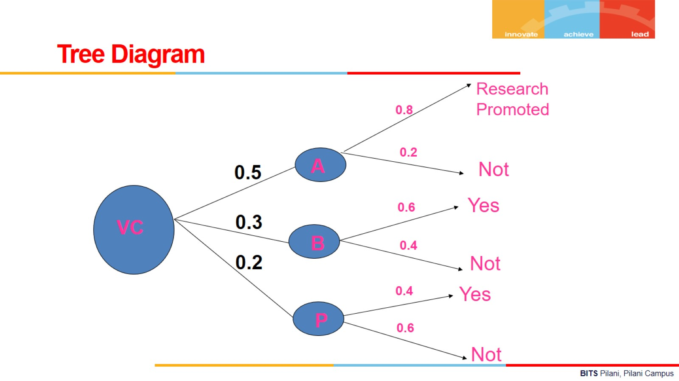

Slide 47
Problem 5
Four technicians regularly make repairs when breakdowns occur on an automated production
line.
Janet, who services 20% of the breakdowns, makes an incomplete repair 1 time in 20;
Tom, who services 60% of the breakdowns, makes an incomplete repair 1 time in 10;
Georgia, who services 15% of the breakdowns, makes an incom­plete repair 1 time in 10;
Peter, who services 5% of the breakdowns, makes an incomplete repair 1 time in 20.
For the next problem with the production line diag­nosed as being due to an initial repair that was
incomplete, what is the probability that this initial repair was made by Janet?

Slide 48
Solution:
Let A be the event that the initial repair was incomplete, B₁ that the initial repair was made by Janet, B₂ that it was made by Tom, B₃ that it was made by Georgia. and B₄ that it was made by Peter.
P(B₁IA) = (0.20)(0.05 )
(0.20 )(0.05 )+ (0.60)(0.10) + (0.15)(0.10)+ (0.05 )(0.05 )
= 0.114
and it is of interest to note that although Janet makes an incomplete repair only 1 out of 20 times, namely, 5% of the breakdowns she services, more than 11% of the incomplete repairs are her responsibility.

Slide 49
Problem 6
Seventy percent of the light aircraft that disappear while in flight in a certain country are subsequently discovered. Of the aircraft that are discovered,60% have an emergency locator, whereas 90% of the aircraft not discovered do not have such a locator. Suppose that a light aircraft has disappeared.
If it has an emergency locator, find the probability that it will not be discovered.
(b) If it doesn’t have a locator, find the probability that it will be discovered.

Slide 50
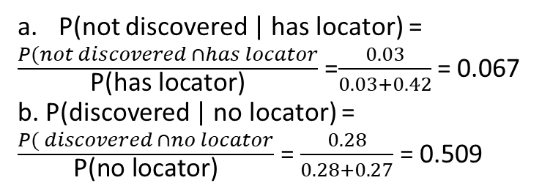
Solution:
The tree diagram below shows the probability for the four disjoint options;
P(the flight is discovered and has a locator)
= P(discovered)P(locator | discovered)
= (.7)(.6) = .42.
0.6
0.42
Has locator
0.7
0.4
disc
No locator
0.28
0.3
0.1
0.03
Not disc
Has locator
0.9
No locator
0.27

Slide 51
Problem 7
Two firms V and W consider bidding on a road-building job, which may or may not be awarded depending on the amounts of the bids. Firm V submits a bid and the probability is 3/4 that it will get the job provided firm W does not bid. The probability is 3/4 that W will bid, and if it does, the probability that V will get the job is only 1/3. (a) what is the probability that V will get the job? (b) If V gets the job, what is the probability that W did not bid?

Slide 52

Solution:

Slide 53
Glossary
Conditional probability
Total Probability
Bayes theorem
MAP Hypothesis
ML Estimate
Naïve Bayes theorem
NB with Laplace correction

Slide 54

IMP Note to Self

Slide 55
Thank you

